Slide 1
Rockbuster Stealth – Preparing for Online Rental Launch
By Jarrett Pugh

Slide 2
Objectives
To adapt to the changing landscape of online movie streaming platforms and launch an online video rental service
To analyze Rockbuster’s film rental history, answer key business questions, and develop data-informed strategies to help with the online video rental launch

Slide 3
Key Questions
What was the average rental duration for all videos?
Which movies contributed the most/least to revenue gained?
Which countries are Rockbuster customers based in?
Where are customers with a high lifetime value based?
Do sales figures vary between geographic regions?

Slide 4
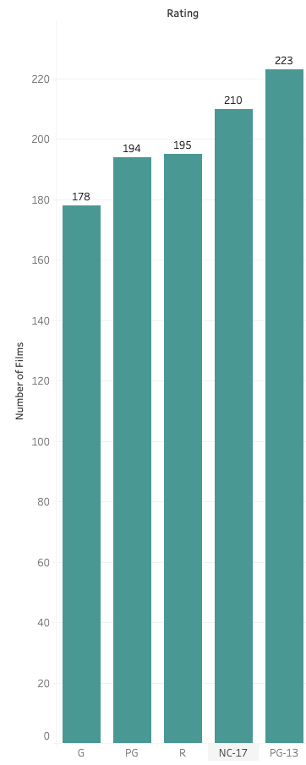
Film inventory overview
1000 different films
1 language (English)
Average rental: 4.985 days
Average number of times rented per film: 15.24
Rental rates: 0.99 – 4.99 (Avg: 2.98)
Film lengths: 46 – 185 (Avg: 115) mins
Film ratings: 5 (see table)

Slide 5
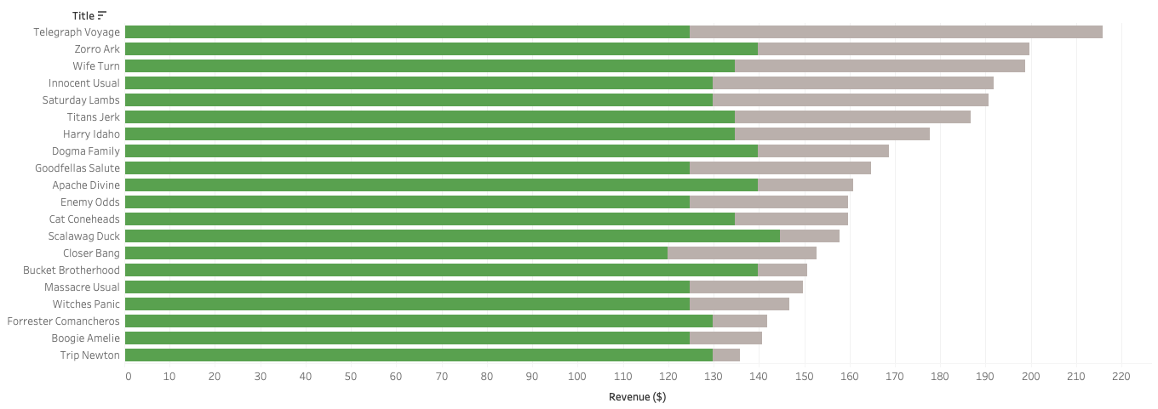

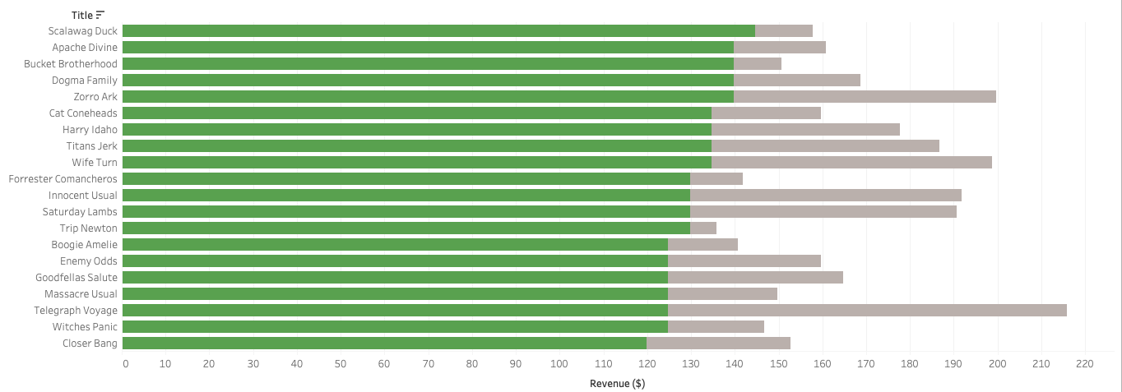
Top Revenue Earners - Films
How was revenue evaluated?
Total revenue was separated between rental revenue (number of rentals * rental price) and rental fees
Rental Revenue + Rental Fees = Total Revenue
Telegraph Voyage ranked 1st in total revenue ($215.75) but 18th in rental revenue ($124.80)
Conversely, Scalawag Duck ranked only 13th in total revenue ($157.71 but 1st in rental revenue ($144.70)
(Top) Movies sorted by total revenue earned
Although the movies in the above chart earned the most total revenue, it should not incorrectly be said that these movies earned the most rental revenue.
Rental revenue is a more trusted KPI than total revenue to predict future total revenue
(Bottom) Films sorted by rental revenue earned without fees included

Slide 6
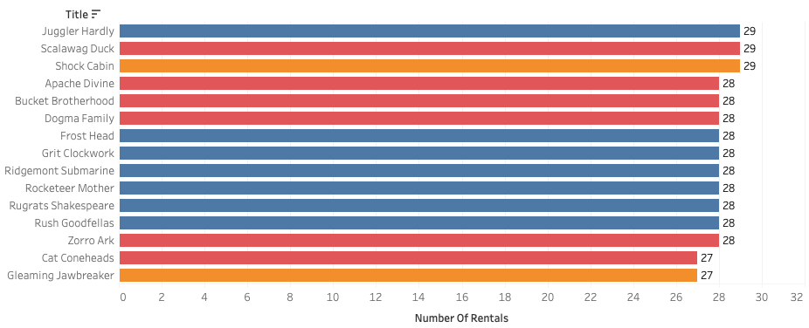


Film Popularity
The most popular films were rented nearly 30 times compared to the average film which was rented just over 15 times (15.2)
Prices do not have a significant correlation to how often films are rented. The average number of times a film is rented varies by less than 1
Films with a higher price point ($4.99) do not deter customer demand
Films with high rental numbers that have lower pricing need price increases
Top 15 Films by Rental Frequency

Slide 7
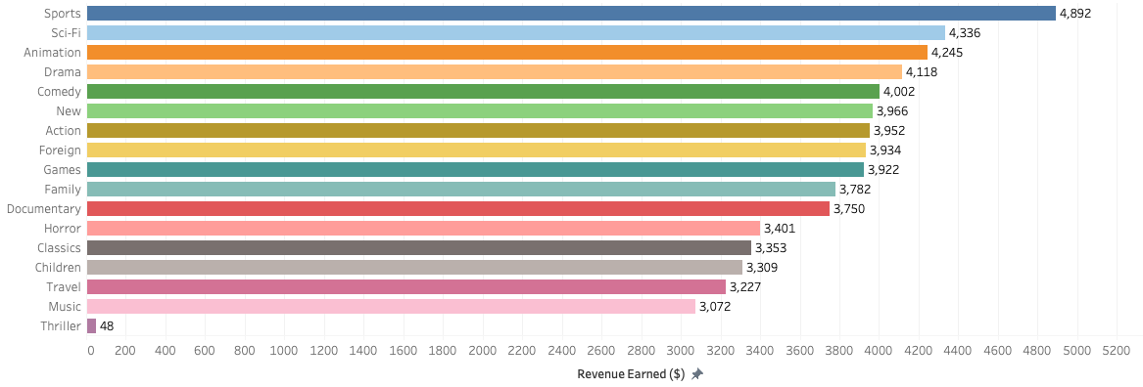
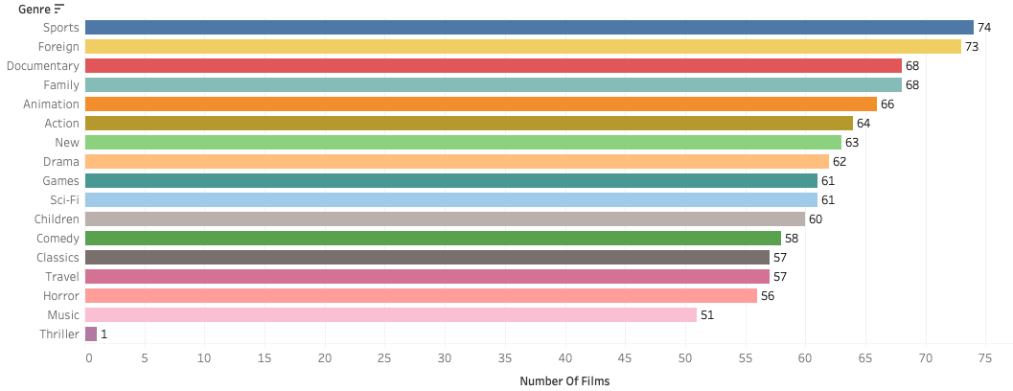
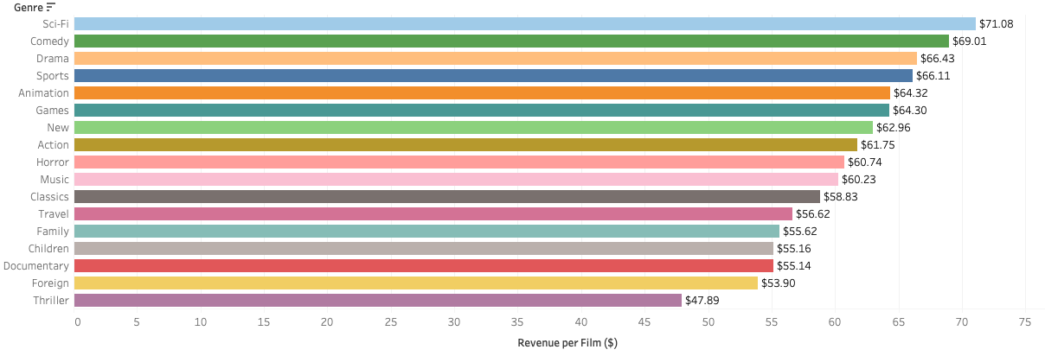
How does genre affect revenue?
Revenue Earned by Genre
Number of Films by Genre
Top 5 Revenue Earners - Genres
Bottom 5 Revenue Earners - Genres
Sports, Sci-Fi, Animation, Drama, and Comedy make up 35.2% of total revenue earned ($21,593)
As a genre’s number of films increases, revenue generally trends upward. But many genres underperform in the metric, revenue per film
Foreign is ranked 2nd in number of films, but 2nd to last in revenue per film!
Despite Sci-Fi and Comedy only having 61 and 58 films respectively, they rank the highest in revenue earned per film
Revenue per Film by Genre

Slide 8
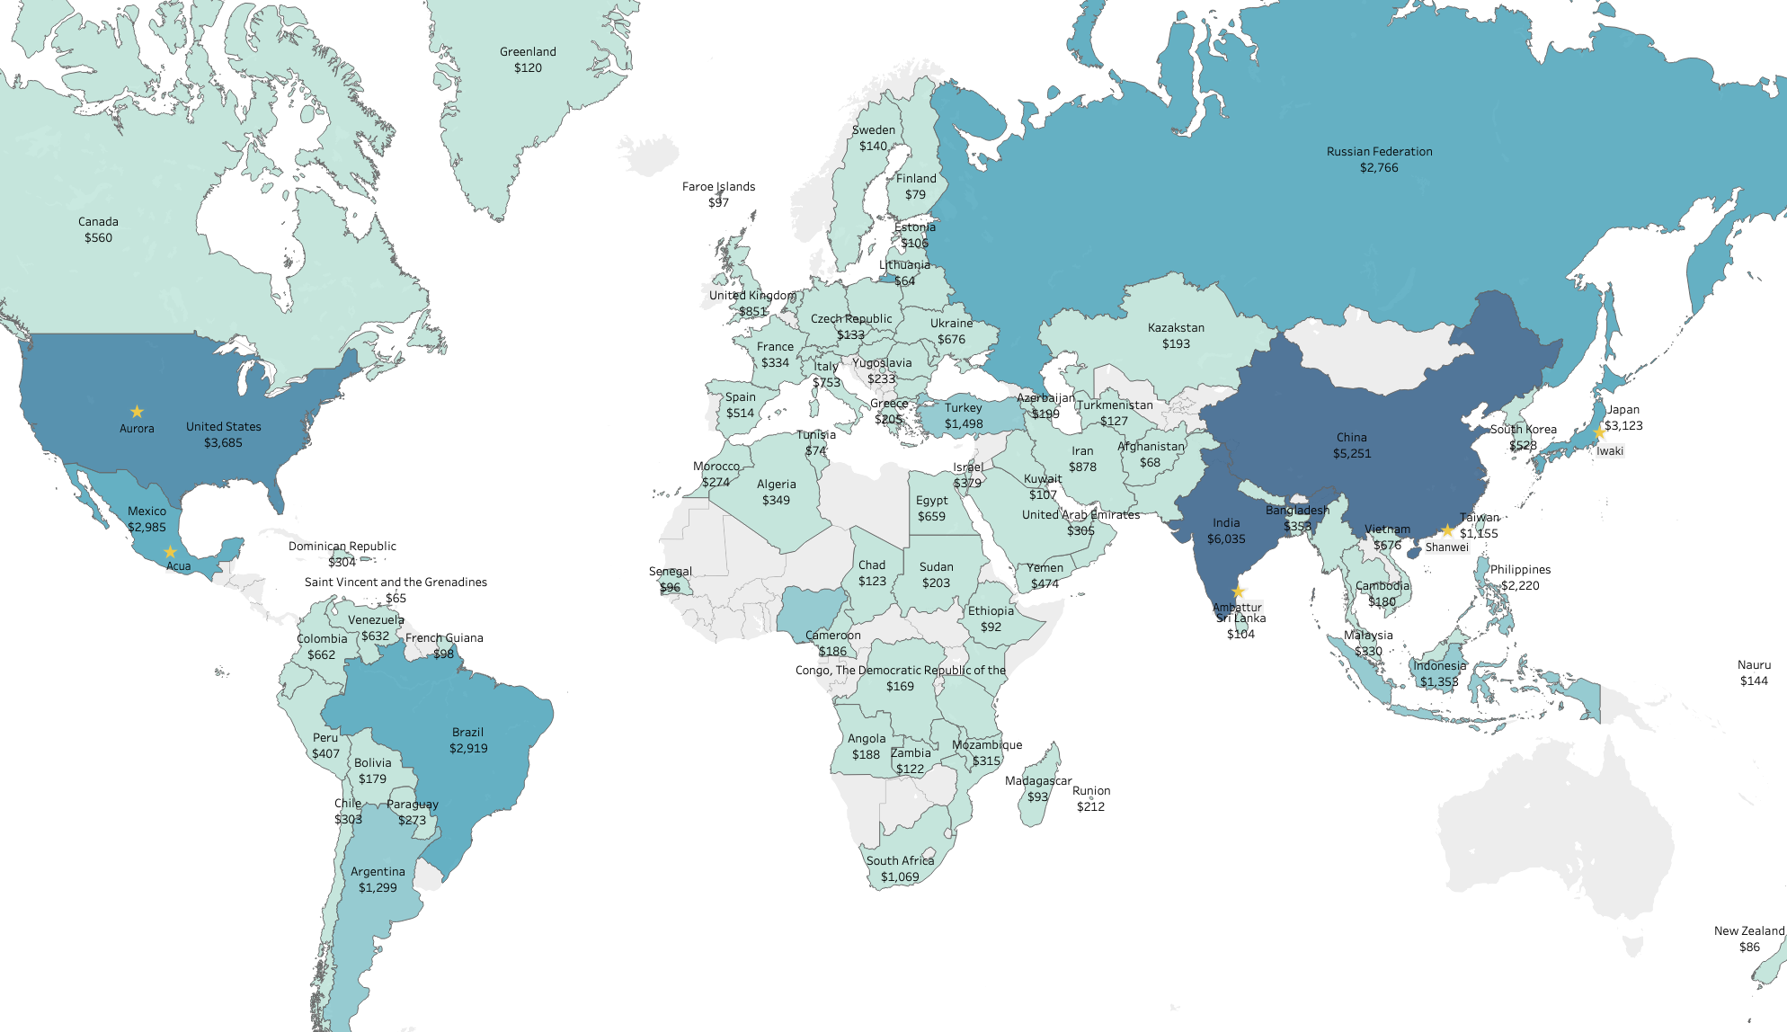


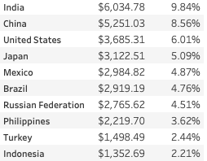
Highest Revenue Countries and Customers
Country
Global Revenue %
Revenue
Asia contains 6 of the top 10 revenue earning countries
The top 5 customers come from 5 different countries, but only 2 different continents (Asia and North America)
Despite having films in only English, films are rented all around the globe!

Slide 9
Recommendations
Focus marketing strategies for the new online rental service to top revenue earning countries and audiences
Send customer survey to top customers to ask for film and genre preferences, expectations, and streaming service needs as well as gain feedback on pricing and subscription models
Establish pricing pilot
Top 1/3 of films (by number of rentals) price increase to $4.99 (if not already at that price)
Middle 1/3 of films priced at $2.99
Bottom 1/3 of films priced at 0.99
Provide existing customers 50% off their first online rental on the new platform
Email customers after rental to recommend other popular films in similar genre

Slide 10
Future Recommendations
Explore increasing diversity of film languages native to other top revenue earning countries
When it is time to renew movie licenses, perform cost analysis to reduce underperforming films and genres
Explore establishing premium subscription to Rockbuster for reduced rental rates to increase customer retention

Slide 11
Questions?
Tableau Public Link: https://public.tableau.com/app/profile/jarrett.pugh/viz/RockbusterStealth_16968176106630/RevenuebyCountrywithTop5Customers

